Slide 1
Systemic Climate risk
Tristan JOURDE (Banque de France)
Quentin MOREAU (University of Glasgow)
2023 RiskLab/BoF/ESRB Conference
Systemic Risk Analytics
June 8-9, 2023

Slide 2
Layout
Introduction
Objective
Framework
Literature review
Data
Results
Robustness
Conclusion
Appendix

Slide 3
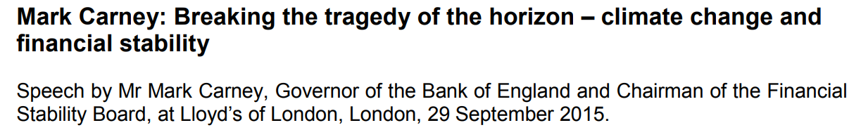



introduction
Source: https://www.bis.org/review/r151009a.pdf

Slide 4
Introduction

Slide 5
Objective
Design a market-based framework to examine the effects of climate risks on the financial sector:
  First-round effects: decrease in value of financial portfolios, credit worthiness of borrowers, etc.
  Second-round effects: climate shocks spread to other institutions through the financial network.
  => Broad definition of « contagion »: Exposure to common shocks, spillovers and pure contagion (Masson, 1998)
Key questions:
  Which are the most vulnerable financial institutions (FIs)?
  Can climate risks generate contagion effects among FIs?
  Can FIs and policymakers undertake actions to mitigate systemic climate risk?

Slide 6
The Framework – Intuition
The economic rationale : climate risks should lead to a repricing of securities (Carney, 2015) held by financial institutions.
Purpose : assess whether climate shocks are reflected into asset prices and are already propagating to/among financial institutions.
The framework complements the forward-looking approach of climate stress tests (e.g., Battiston et al., 2017; Vermeulen et al., 2018; ECB, 2022), based on long-term scenarios, but subject to uncertainty (Barnett et al., 2020).

Slide 7
The Framework – Summary
A/ DESIGN INPUTS
STEP 1
Systemic risk measure
STEP 2
Climate risk factors
B/ TEST FOR SYSTEMIC CLIMATE RISK
STEP 3
Two-pass test procedure
C/ ACTIONS TO MITIGATE SYSTEMIC CLIMATE RISK
STEP 4
Determinants of FIs exposure
to climate risks

Slide 8
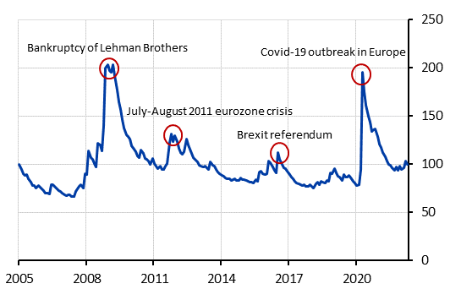
The Framework – STEP I
Construct a “market-based” systemic risk measure:
  It captures 2 elements of systemic risk: (a) individual tail risks and
  (b) contagion effects.
  Dynamically estimate the Value-at-Risk (VaR) of each FIs and extract covariations (using a PCA analysis).
  Related indicators: Adams et al. (2014), Adrian and Brunnermeier (2016), and Kelly and Jiang (2014).

Slide 9
The Framework – STEP II
Build “market-based” climate risk factors for NFC:
  The factors capture the effect of climate shocks on the value of non-financial firms.
  We disentangle between (a) transition and (b) physical risks.
  Long-short factor mimicking portfolios (e.g., Fama & French, 1993) based on climate characteristics.
  At each point in time, we sort firms into brown and green portfolios and compute the difference of returns between the portfolios.
  Finally, we estimate the dynamic VaR of these factors
    (i) for consistency with the first step,
    (ii) to reflect extreme climate shocks,
    (iii) to account for uncertainty in the pricing of green and brown firms.

Slide 10
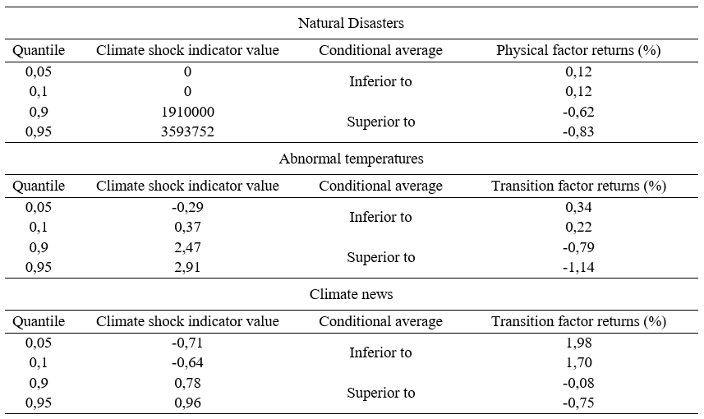
The Framework – STEP II
Factor reaction to endogeneous climate shocks:

Slide 11
The Framework – STEP III
Design a two-pass procedure to detect systemic climate risks
  Time-series regression of the variations in systemic risk on climate risk factors.
  Cross-sectional regression of financial institutions' contributions to systemic risk on financial institutions' exposures to climate risks.

Slide 12
The Framework – STEP IV
Determinants of FIs’ climate risk exposures:
  Financial characteristics.
  Environmental and governance features.
  Indirect carbon emissions (Scope 3), originating from the holding of securities and loans by financial institutions.
  Ownership structure (institutional / non-institutional)
  Climate disclosure and adaptation measures.

Slide 13
Literature review (I)
We contribute to 3 strands of literature:
  The integration of climate risks into asset prices (e.g., Ardia et al., 2020; Bolton and Kacperczyk, 2021; Choi et al., 2020; Alok et al., 2020; Hong et al., 2019; Kruttli et al., 2021)
We propose a flexible framework to assess whether extreme climate risks are reflected in the tail risk of equity markets.
  The effect of climate risks on financial stability (e.g., Aevoae et al., 2022; Alessi et al., 2021; Anginer et al., 2018; Jung et al., 2021; Ojea-Ferreiro et al., 2022)
Our framework focuses on tail risk dependence among FIs, allowing us to capture the potential second-round effects of climate risks.

Slide 14
Literature review (II)
We contribute to 3 strands of literature:
  The link between (i) climate risks and (ii) environmental characteristics and disclosure (e.g., Dhaliwal et al., 2011; Ilhan et al., 2021; Li et al., 2020; Sautner et al., 2020)
First to study the determinants of market-based measure of tail climate risks and adaptation measures.

Slide 15
Data (I)
Data goes from 2005 to 2022 for members of the European Union (+ UK, Switzerland and Norway).
371 active stocks of financial institutions (Banks, life insurers, non-life insurers, financial services, real estate - REIS and REITs).
Thousands of active and dead non-financial European stocks to build climate risk factors.

Slide 16
Data (II)
For all companies, we retrieve:
  Financial data
    Datastream Refinitiv: prices including dividends, market capitalizations, book values of equity, cash holdings, total assets, incomes, net sales, and fixed assets
  Environmental data
    Datastream Refinitiv: Carbon emissions (Scope 1 & 2)
    Carbone 4: Carbon emissions induced by portfolio holdings (Scope 3) for financial institutions
    Trucost: Main physical risk scores
    ISS-ESG/Carbone4: Alternative physical risk scores
    Bloomberg/Datastream: Climate disclosure, ESG characteristics
  Institutional ownership data
    Securities Holdings Statistics (SHS-S) database: FIs holders by sector
    (Percentage of ownership by banks, insurance, and pension funds : items S_122, S_128, and S_129)

Slide 17
DATA (iii)
Control variables that can help explain variations in systemic risk:
  Systematic risk factors based on equity market data (Harvey et al, 2016)
    Hou-Xue-Zhang, Kenneth-French, Pastor-Stambaugh, AQR data libraries : size, value, momentum, expected growth, liquidity, quality-minus-junk, etc.
    => They capture « different set of bad times » (Ang, 2014), such as small and value firm distress (Fama and French, 2015); momentum crashes (Daniel and Moskowitz, 2016)
  Other macroeconomic and financial factors (Lettau et al., 2008; Adrian et al, 2016)
    Bloomberg, ECB, Eurostat, Fred: default premium, interbank market liquidity, yield curve spread, economic sentiment, etc.

Slide 18
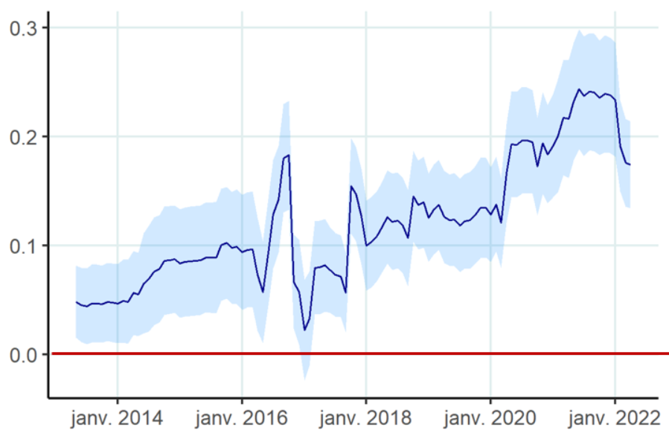
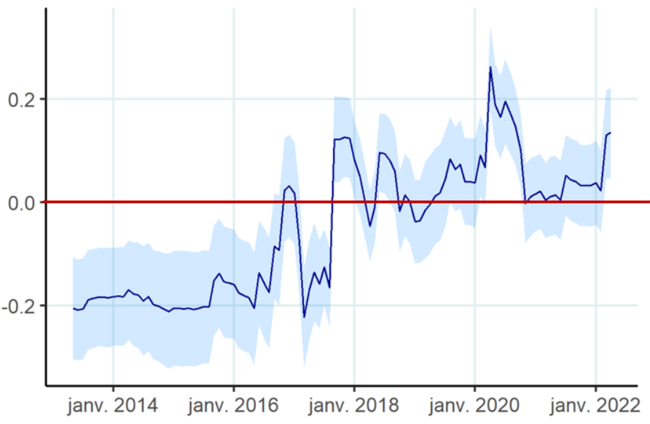



Results – Individual exposures to climate risks
“Climate” Exposure CoVaR measure that incorporates extreme climate risks as potential stress factors for financial institutions.
Run individual time-series regressions
$${\hat{∆VaR}}_{i,t} =α+ β_{BMG}{BMG}_{t}+β_{VMS}{VMS}_{t}+\sum_{i=1}^{I}{β_{f_{i}}f_{i,t}}+ε_{t}$$
Aggregate results using the mean-group estimator (Pesaran, 1995)
Dynamic VaR of FIs
Transition risk factor
Physical risk factor
Market risk factors
Transition risk ($β_{BMG}$)
Physical risk ($β_{VMS}$)

Slide 19
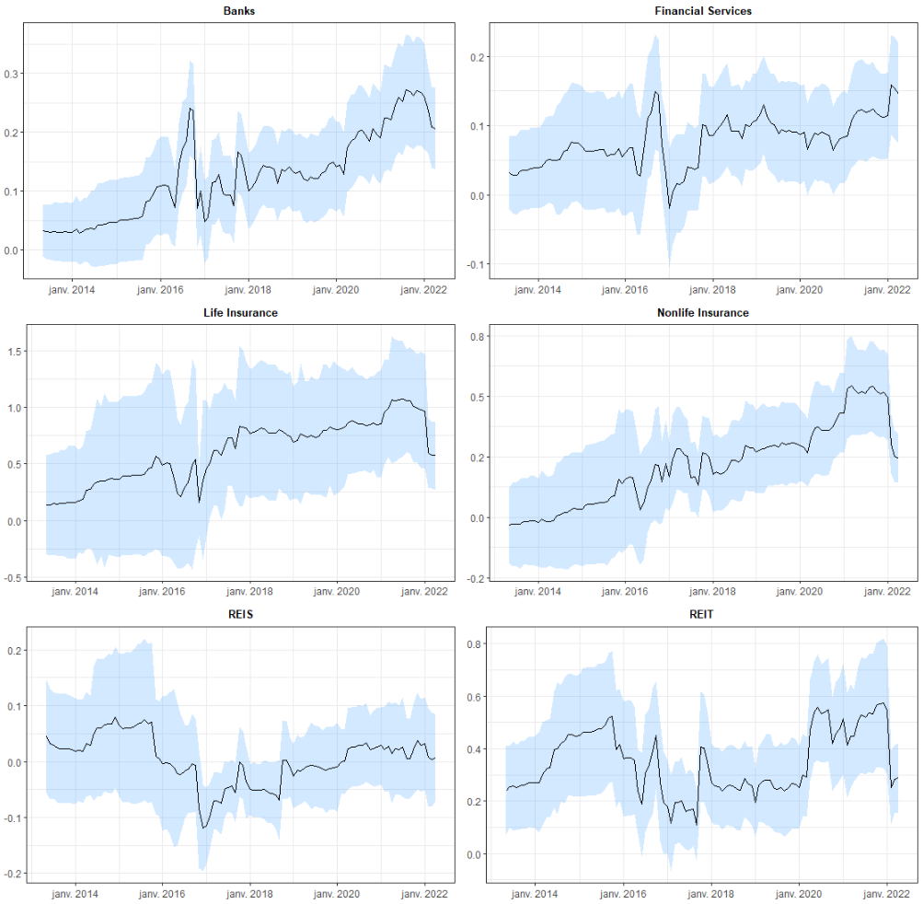
Results – Transition risk by financial industry

Slide 20
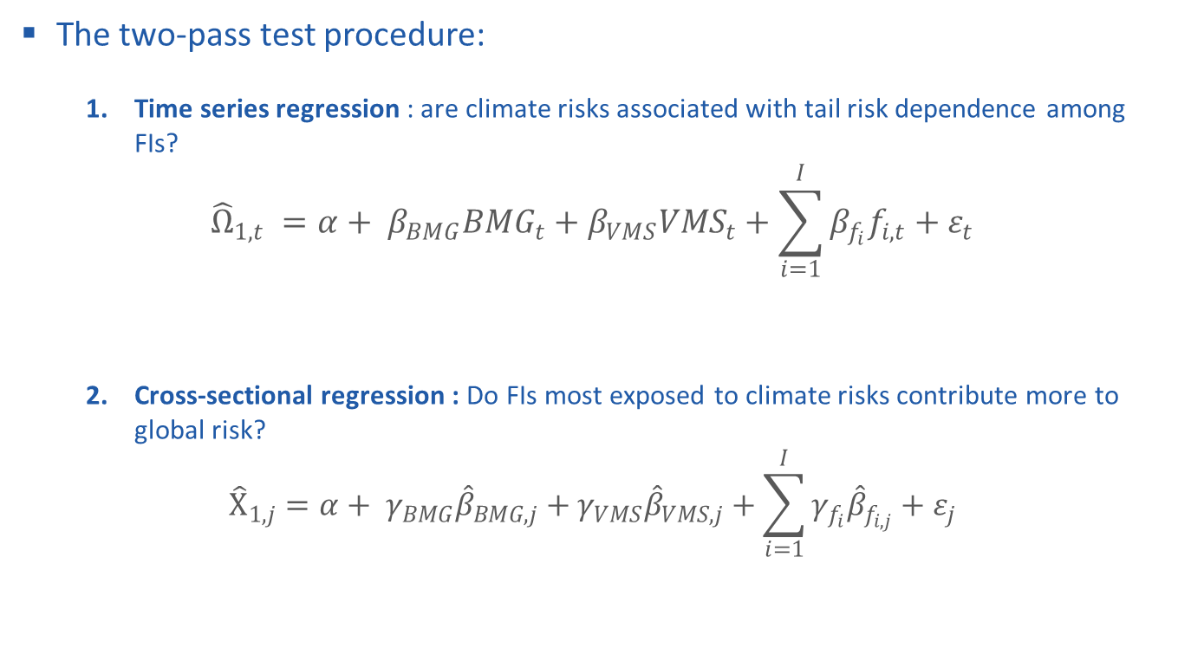
Results – Effect of climate risks on systemic risk (I)
The two-pass test procedure:
  Time series regression : are climate risks associated with tail risk dependence among FIs?
$${\hat{Ω}}_{1,t} =α+ β_{BMG}{BMG}_{t}+β_{VMS}{VMS}_{t}+\sum_{i=1}^{I}{β_{f_{i}}f_{i,t}}+ε_{t}$$
  Cross-sectional regression : Do FIs most exposed to climate risks contribute more to global risk?
$${\hat{Χ}}_{1,j}=α+ γ_{BMG}{\hat{β}}_{BMG,j}+γ_{VMS}{\hat{β}}_{VMS,j}+\sum_{i=1}^{I}{γ_{f_{i}}{\hat{β}}_{f_{i,j}}}+ε_{j}$$
Covariations in tail risk
among FIs (1st PC)
Contribution of each FIs to
tail risk dependence
(weights on the 1st PC)

Slide 21
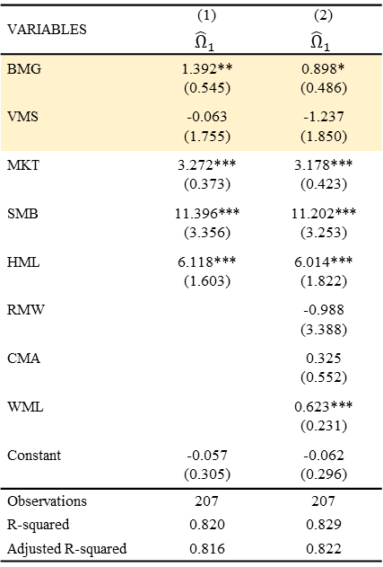
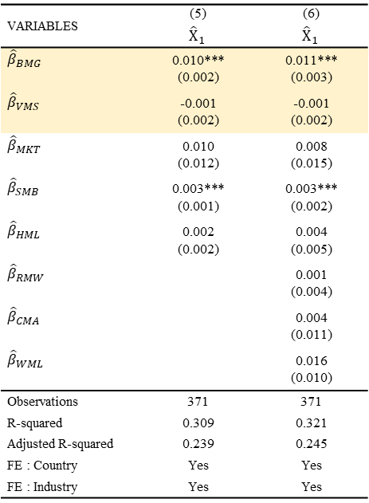
Results – Effect of climate risks on systemic risk (II)
Transition risk affects systemic risk, while physical risk does not.
The magnitude of the effect of transition risk is moderate.
Results are robust to alternative sets of systematic and market stress factors.
In the time series In the cross-section
VARIABLES | (1) | (2)
 | $${\hat{Ω}}_{1}$$ | $${\hat{Ω}}_{1}$$
BMG | 1.392** | 0.898*
 | (0.545) | (0.486)
VMS | -0.063 | -1.237
 | (1.755) | (1.850)
MKT | 3.272*** | 3.178***
 | (0.373) | (0.423)
SMB | 11.396*** | 11.202***
 | (3.356) | (3.253)
HML | 6.118*** | 6.014***
 | (1.603) | (1.822)
RMW |  | -0.988
 |  | (3.388)
CMA |  | 0.325
 |  | (0.552)
WML |  | 0.623***
 |  | (0.231)
Constant | -0.057 | -0.062
 | (0.305) | (0.296)
Observations | 207 | 207
R-squared | 0.820 | 0.829
Adjusted R-squared | 0.816 | 0.822
VARIABLES | (5) | (6)
 | $${\hat{Χ}}_{1}$$ | $${\hat{Χ}}_{1}$$
$${\hat{β}}_{BMG}$$ | 0.010*** | 0.011***
 | (0.002) | (0.003)
$${\hat{β}}_{VMS}$$ | -0.001 | -0.001
 | (0.002) | (0.002)
$${\hat{β}}_{MKT}$$ | 0.010 | 0.008
 | (0.012) | (0.015)
$${\hat{β}}_{SMB}$$ | 0.003*** | 0.003***
 | (0.001) | (0.002)
$${\hat{β}}_{HML}$$ | 0.002 | 0.004
 | (0.002) | (0.005)
$${\hat{β}}_{RMW}$$ |  | 0.001
 |  | (0.004)
$${\hat{β}}_{CMA}$$ |  | 0.004
 |  | (0.011)
$${\hat{β}}_{WML}$$ |  | 0.016
 |  | (0.010)
Observations | 371 | 371
R-squared | 0.309 | 0.321
Adjusted R-squared | 0.239 | 0.245
FE : Country | Yes | Yes
FE : Industry | Yes | Yes

Slide 22
Results – Characteristics correlated with transition risk
FIs with high transition risk exposure have higher market capitalizations (ECB, 2022).
FIs with lower Scope3 emissions, reliable emission data/emission reduction pathways, and with long-term orientation are less exposed to transition risk.

Slide 23
Results – Characteristics correlated with Physical risk
FIs with high physical risk levels have lower market capitalizations.

Slide 24
Results – Adaptation measures to Transition risk
FIs with higher exposure to transition risk engage in selective ESG/climate disclosure (e.g., Management Discussion and Analysis section of annual reports, allowing communication in a flexible manner (Brown et al., 2021).
Potential suspicion of greenwashing (Campbell et al., 2014; Yu et al., 2020).
Column (5) : Evidence against regulatory capture concerns (see also Schneider et al., 2023).

Slide 25
Results – Adaptation measures to physical risk
As most investors expect physical risk to become material within a few years (Krueger et al., 2020), financial institutions might already take action to face it.
FIs with higher exposure to physical risk engage in various initiatives to reduce their environmental footprints.

Slide 26
Robustness TESTs
Use alternative climate risk factors (L/S portfolios based on different characteristics).
  Transition risk factors: 90% correlation based on Scope 1 (reported) only vs. Scopes 1 + 2 (estimated & reported)
  Physical risk factors: Only 26% correlation on average between the factors based on Trucost, ISS-ESG and Carbone4
  Large disagreement between physical scores that can lead to dispersion in investment flows, limiting or delaying the incorporation of physical risks into asset prices (see Billio et al., 2021 for ESG scores).
  The results remain non-significant based on each physical risk score.

Slide 27
Conclusion
We build a market-based framework to:
  identify the FIs most exposed to tail climate risks
  detect potential contagion effects arising from climate risks
We find that transition risk affects systemic risk, while physical risk does not.
FIs that are less exposed to transition risks have:
  lower Scope3 emissions, reliable emission data/emission reduction pathways
  long-term orientation
Our framework is flexible :
  It can be used to dynamically monitor whether the effect of climate risks on financial stability is becoming a growing concern from an investor perspective
  It can be used on other countries, sectors, asset types and periods.
  It can be used to assess other types of emerging risk for financial stability.

Slide 28

Thank you for your attention !
Any feedback is highly welcome
The paper is available on SSRN :
Email:
tristan.jourde@banque-france.fr
quentin.moreau@glasgow.ac.uk

Slide 29
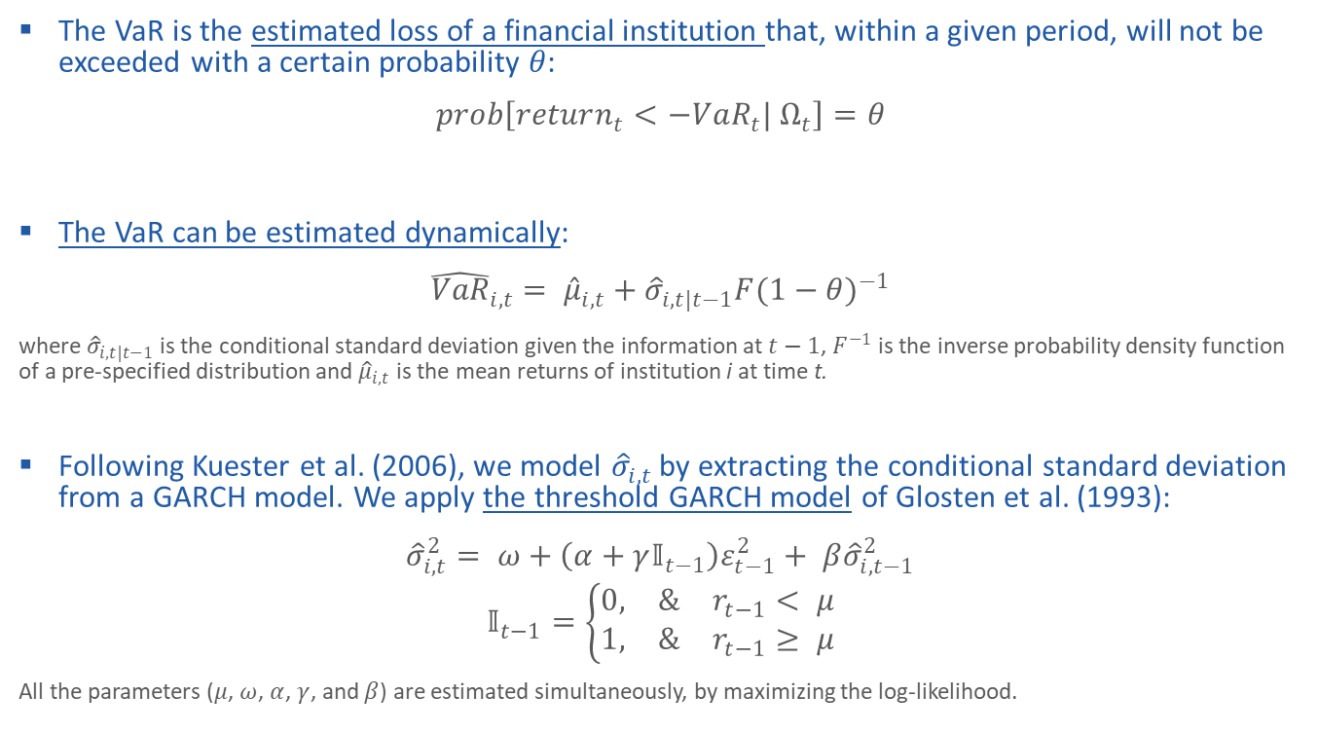
Appendix – Dynamic VaR estimation
The VaR is the estimated loss of a financial institution that, within a given period, will not be exceeded with a certain probability 𝜃:
$$prob\left[return_{t}<−VaR_{t}| Ω_{t}\right]=θ$$
The VaR can be estimated dynamically:
$${\hat{VaR}}_{i,t}= {\hat{μ}}_{i,t}+{\hat{σ}}_{i,t|t−1}{F(1−θ)}^{−1}$$
where ${\hat{σ}}_{i,t|t−1}$ is the conditional standard deviation given the information at $t−1$, $F^{−1}$ is the inverse probability density function of a pre-specified distribution and ${\hat{μ}}_{i,t}$ is the mean returns of institution i at time t.
Following Kuester et al. (2006), we model ${\hat{σ}}_{i,t}$ by extracting the conditional standard deviation from a GARCH model. We apply the threshold GARCH model of Glosten et al. (1993):
$${\hat{σ}}_{i,t}^{2}= ω+\left(α+γ𝕀_{t−1}\right)ε_{t−1}^{2}+ β{\hat{σ}}_{i,t−1}^{2}$$
$$𝕀_{t−1}=\left\{\begin{aligned}0, &r_{t−1}< μ \\ 1, &r_{t−1}≥ μ\end{aligned}\right.$$
All the parameters ($μ$, $ω$, $α$, $γ$, and $β$) are estimated simultaneously, by maximizing the log-likelihood.

Slide 30
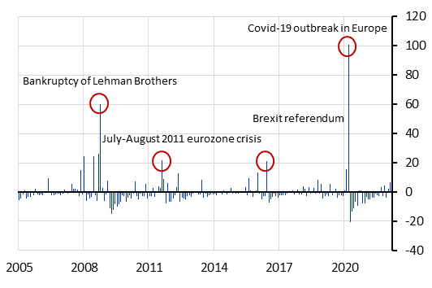

Appendix – Time variation in systemic risk
The indicator represents the first principal component ${\hat{Ω}}_{1}$accounting for the common variations in the VaR of FIs.
The chart on the left is in levels (January 2005 = 100), while the chart on the right is in first difference.

Slide 31
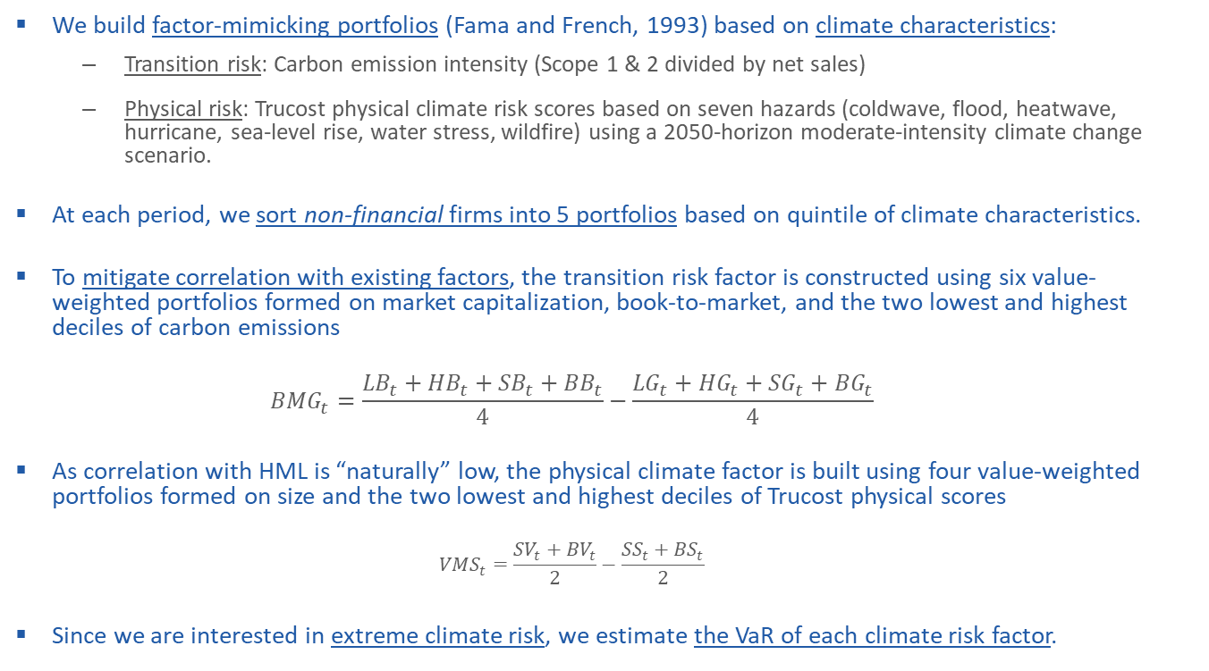
Appendix – Climate risk Factors
We build factor-mimicking portfolios (Fama and French, 1993) based on climate characteristics:
  Transition risk: Carbon emission intensity (Scope 1 & 2 divided by net sales)
  Physical risk: Trucost physical climate risk scores based on seven hazards (coldwave, flood, heatwave, hurricane, sea-level rise, water stress, wildfire) using a 2050-horizon moderate-intensity climate change scenario.
At each period, we sort non-financial firms into 5 portfolios based on quintile of climate characteristics.
To mitigate correlation with existing factors, the transition risk factor is constructed using six value-weighted portfolios formed on market capitalization, book-to-market, and the two lowest and highest deciles of carbon emissions
  $${BMG}_{t}=\frac{{LB}_{t}+{HB}_{t}+{SB}_{t}+{BB}_{t}}{4}−\frac{{LG}_{t}+{HG}_{t}+{SG}_{t}+{BG}_{t}}{4}$$
As correlation with HML is “naturally” low, the physical climate factor is built using four value-weighted portfolios formed on size and the two lowest and highest deciles of Trucost physical scores
  $${VMS}_{t}=\frac{{SV}_{t}+{BV}_{t}}{2}−\frac{{SS}_{t}+{BS}_{t}}{2}$$
Since we are interested in extreme climate risk, we estimate the VaR of each climate risk factor.

Slide 32
Appendix – Factor correlation
 | BMG | VMS | MKT | SMB | HML | RMW | CMA | WML | RR | ML | DP | YC | NS
VMS | -5%
MKT | 0% | 25%
SMB | 10% | 15% | 25%
HML | -22% | 13% | 37% | 33%
RMW | -1% | 10% | 31% | 15% | 47%
CMA | 19% | 17% | 32% | 23% | -2% | 15%
WML | 21% | 26% | 26% | 15% | 21% | 22% | 17%
RR | 4% | 0% | -2% | -1% | -14% | -11% | 11% | -11%
ML | -5% | 12% | 29% | 27% | 11% | 33% | 13% | 12% | -13%
DP | -3% | 26% | 80% | 41% | 41% | 38% | 29% | 32% | -1% | 39%
YC | -4% | 1% | 3% | -4% | 4% | 2% | 1% | 5% | 5% | 12% | 8%
NS | -6% | 9% | 16% | -2% | 17% | -4% | 1% | 8% | 6% | 3% | 7% | 27%
ES | -7% | 13% | 47% | 46% | 63% | 12% | 12% | 19% | 4% | 7% | 47% | 1% | 17%

Slide 33
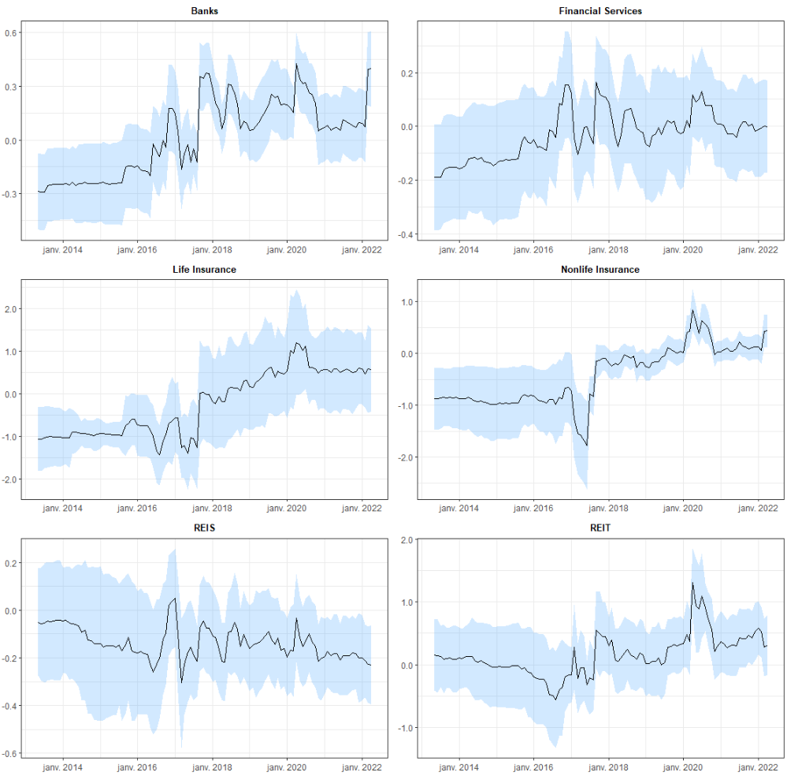
Appendix – Physical risk by financial industry

Slide 34
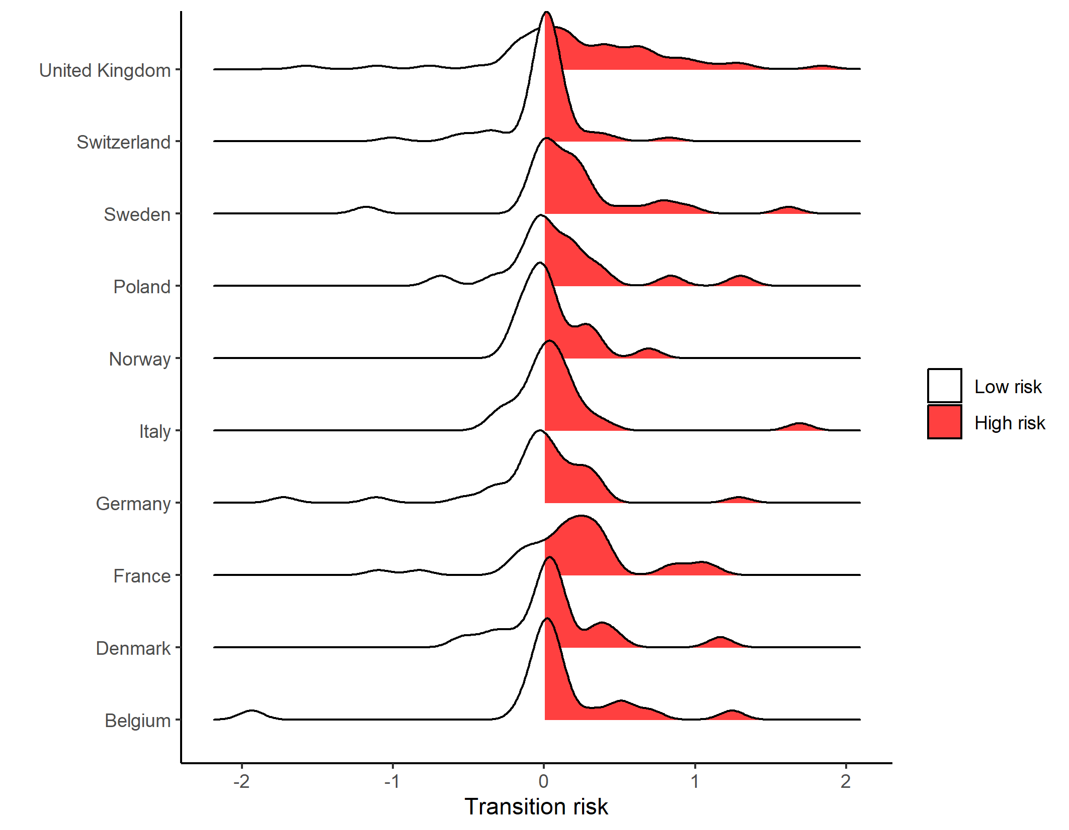
Appendix – Transition risk by country

Slide 35
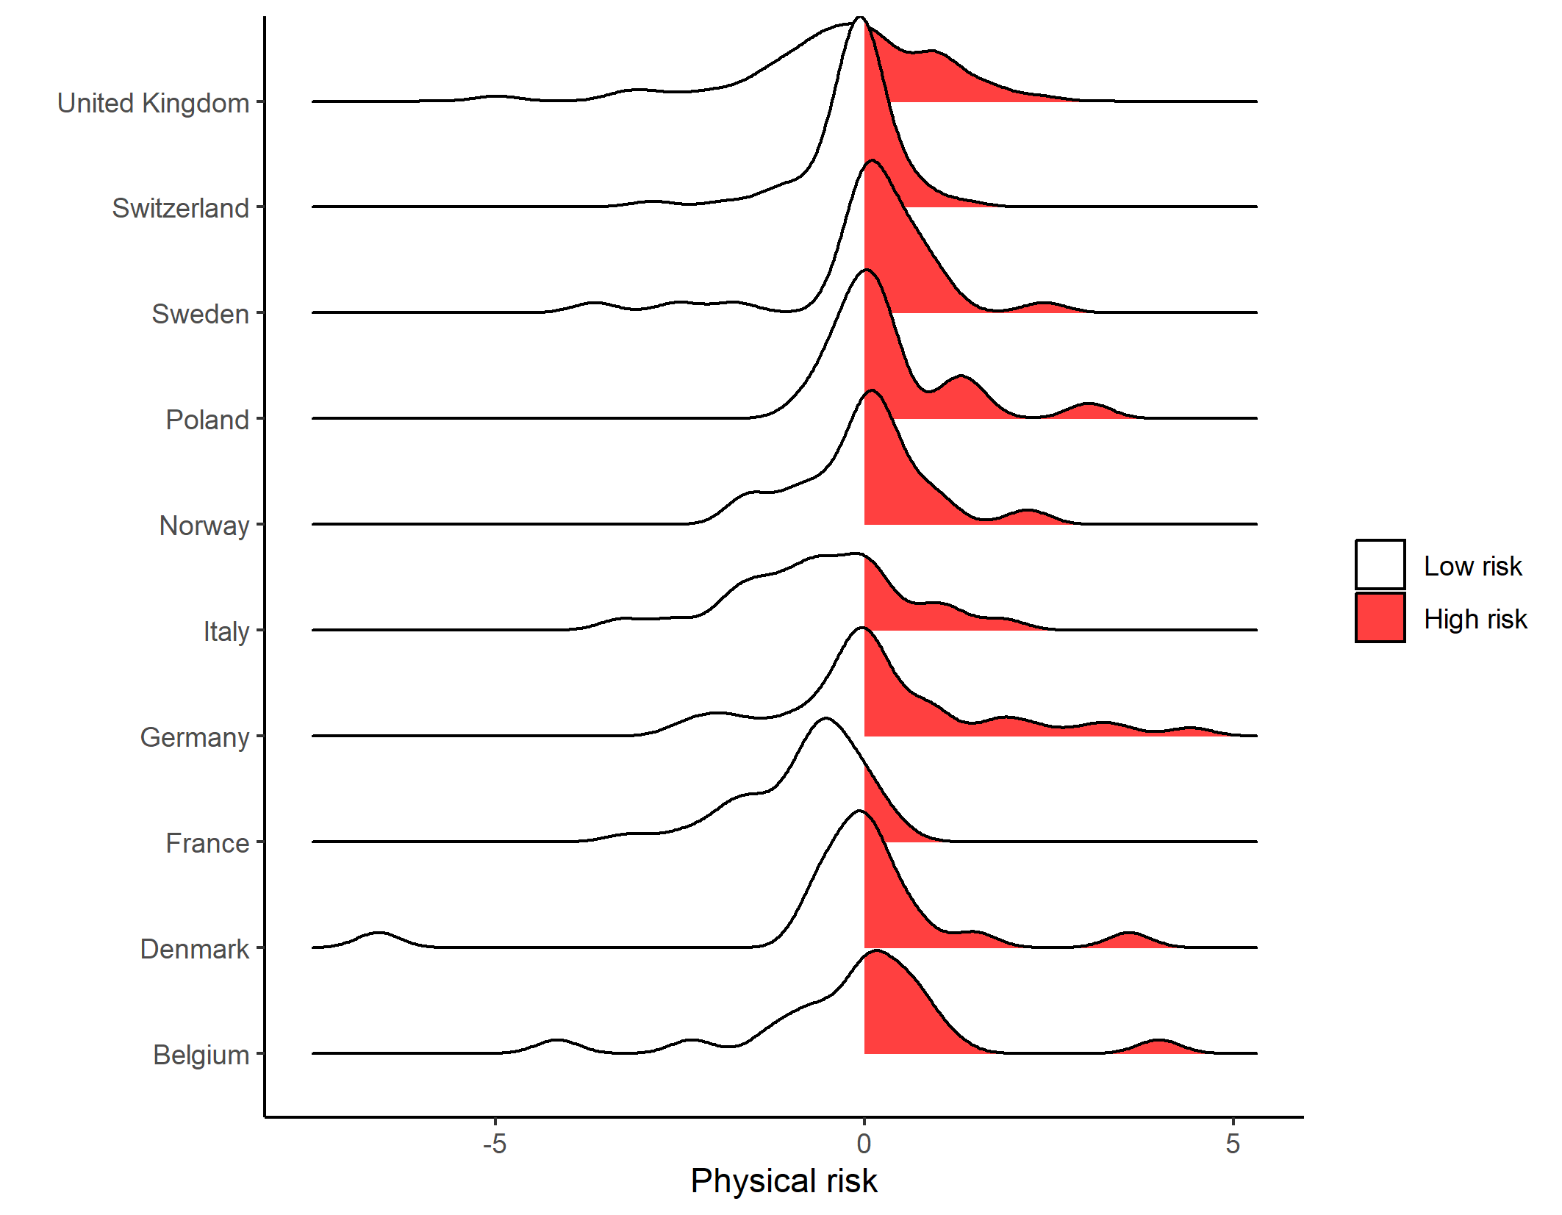
Appendix – Physical risk by country

Slide 36
Appendix – Other factors description (I)
Variable | Description
CMA DP EG ES HML IA LIQ ME MKT | Difference between the returns on portfolios of low and high investment stocks (Conservative-Minus-Aggressive factor), based on the change in total assets divided by total assets from Kenneth French website library. Default premium computed as the spread between the ICE high yield euro corporate rates against the 3-month Euribor rate (Fred database). Difference between the returns of portfolios of high and low expected growth stocks (Expected Growth factor) from Hou-Xue-Zhang q-factors data library. Economic Sentiment indicator (Eurostat). Difference between the returns on portfolios of high and low book-to-market stocks (High-Minus-Low factor) from Kenneth French website library. Difference between the returns on portfolios of high and low investment-to-assets stocks (Investment/Assets factor) from Hou-Xue-Zhang q-factors data library. Non-traded liquidity factor of Pastor and Stambaugh (2003) from https://faculty.chicagobooth.edu/lubos-pastor/data Difference between the returns on portfolios of small and large stocks from Hou-Xue-Zhang q-factors data library. Difference between the returns on the market portfolio and the risk-free rate (Market factor) from Kenneth French website library.

Slide 37
Appendix – Other factors description (II)
Variable | Description
ML NS QMJ RMW ROE RR SMB WML YC | Interbank Market Liquidity indicator, calculated as the spread between the 3-month Euribor rate against the equivalent Overnight Indexed Swap rate. North-South spread, computed as the difference between the 10-year German sovereign bond rate against an average of Greece, Ireland, Italy, Spain, and Portugal 10-year rates (European Central Bank). Quality-Minus-Junk (QMJ) factor that invests long quality stocks and shorts junk stocks (Asness et al., 2014) from the AQR library. Difference between the returns of robust and weak stocks (Robust-Minus-Weak factor), based on operational profitability (revenues divided by book equity) from Kenneth French website library. Difference between the returns on portfolios of high and low profitability stocks (Return on Equity factor), based on the income before extraordinary items divided by one-quarter-lagged book equity; from Hou-Xue-Zhang q-factors data library. Risk Reversal on the USD/EUR options from Bloomberg. Difference between the returns on portfolios of small and large stocks (Small-Minus-Big factor) from Kenneth French website library. Difference between the returns on portfolios of past winner and past loser stocks (Momentum factor) from Kenneth French website library. Yield Curve indicator, computed as the spread between 10-year and 2-year Euro Area composite rates (European Central Bank).

Slide 38
Appendix – Other variable description (II)
Variable | Description
Beta Board LT incentives Cash ClimateScenarioAnalysis DiscussClimateRisk Environmental Dislosure Score EnvironmentalProducts EnvironmentalTeam ESG Disclosure Score | Equity beta (897E in Datastream). Dummy variable equal to one if board members have long-term compensation incentives (from CGCPDP052 in Refinitiv ESG). Ratio of cash (item WC02005 in Worldscope Datastream) to total assets (item WC02999 in Worldscope Datastream). Dummy variable equal to one if the financial institution has conducted a climate scenario analysis for its portfolio of financial assets (CLIMATE_SCENARIO_ANALYSIS in Bloomberg). Dummy variable equal to one if the Management Discussion and Analysis (MD&A) or its equivalent risk section of the financial institution's annual report discusses business risks related to climate change (CLIMATE_RISKS in Bloomberg). Score based on the extent of a company's Environmental disclosure (ENVIRONMENTAL_PILLAR_DISCLOSURE in Bloomberg). Dummy variable equal to one if the financial institution has at least one product line or service that is designed to have positive effects on the environment (item ENPIDP019 in Datastream). Dummy variable equal to one if the financial institution has an environmental management team (item ENRRDP004 in Datastream). Score based on the extent of a company's Environmental, Social, and Governance (ESG) disclosure (ESG_DISCLOSURE_SCORE in Bloomberg).

Slide 39
Appendix – Other variable description (II)
Variable | Description
Institutional ownership IntegratedStrategy LogCarbonOffsets LogMarketValue LowScope3intensity MtoB NetIncome PolicyEngagement ReductionTargetReached ResourceScore SupplierClimateEngagement | Percentage of ownership by banks, insurance, and pension funds (sum of items S_122, S_128, and S_129 from the Securities Holdings Statistics database) Dummy variable equal to one if the financial institution integrates extra-financial factors in its management discussion and analysis (MD&A) section in the annual report. Natural logarithm of the equivalent of the CO2 offsets, credits, and allowances purchased and/or produced by the financial institution during the year. Natural logarithm of market capitalization (item MV in Datastream, expressed in million euros). Dummy variable equal to one if the financial institution’s Scope3 emissions to revenues (in million USD) ratio is in the bottom quartile (from item in Datastream). Ratio of market value of equity (item MV in Datastream, expressed in million euros) to book value of equity (item WC03501 in Worldscope Datastream, expressed in thousand euros), multiplied by 1,000. Ratio of net income (item WC01751 in Worldscope Datastream) to total assets (item WC02999). Dummy variable equal to one if the financial institution engages with policymakers on possible responses to climate change (from CDP). Dummy variable equal to one if the financial institution has reached or completed an emissions reduction target during the year (from CDP). Resource score, reflecting the financial institution’s performance and capacity to reduce the use of materials, energy, or water, and to find more eco-efficient solutions (item TRESGENRRS in Datastream). Dummy variable equal to one if the financial institution engages with its suppliers on climate change issues (from CDP).
VerifiedScope3 | Dummy variable equal to one if all of the financial institution’s Scope 3 emissions have been verified by a third party (from CDP).

