Slide 1
Machine Learning: The Basics
Dipl.-Ing. Dr.techn. Alexander Jung
Professor of Machine Learning, Aalto University
Principal AI Scientist, Silo AI

Slide 2

Regulating/Using AI needs a handy language!
https://aaltodictionaryofml.github.io/ADictML.pdf

Slide 3
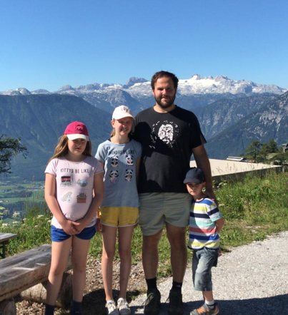



About me.
2012: Phd in Electrical Engineering, TU Wien
2012 – 2015: Post-Doc TUW, ETH Zurich
2015 - : Prof. for ML @ Aalto
2019- : Instructor at Aalto EE
2022 -: Principal AI Scientist at Silo AI

Slide 4
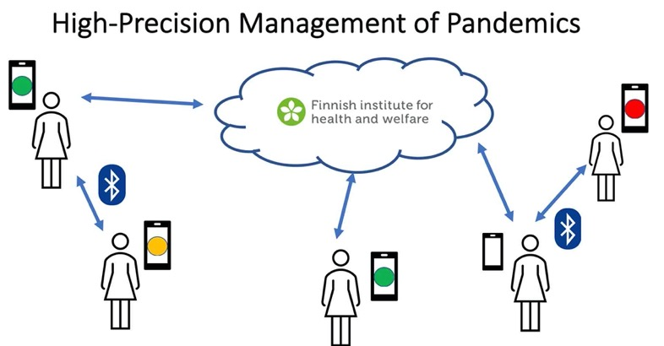
RA1: Networked Federated Learning.
Y. Sarcheshmehpour, M Leinonen and AJ, “Federated Learning From Big Data Over Networks”, IEEE ICASSP, 2021.
AJ, “Networked Exponential Families for Big Data Over Networks,” in IEEE Access, 2020, doi: 10.1109/ACCESS.2020.3033817.
AJ, N. Tran, “Localized Linear Regression in Networked Data,” in IEEE SPL, 2019, doi: 10.1109/LSP.2019.2918933.
Notes:
Our current research focus is two areas. The first research area is federated mutl-task learning which is relevant e.g. for the high-precision management of pandemics. Indeed, the personalized predicition of infection risks results in a networked collection of individual learning tasks. Each single task corresponds to learning accurated infection risk predictors for a particular person. I will talk more about how the statistical and computational aspects of such federated multit-task earning problems udring the main part of my talk.

Slide 5
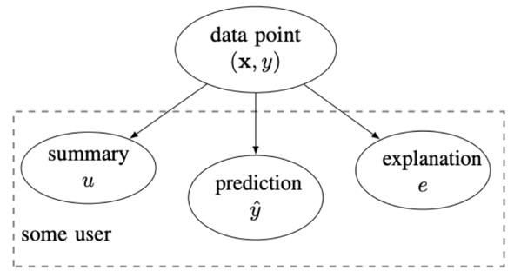
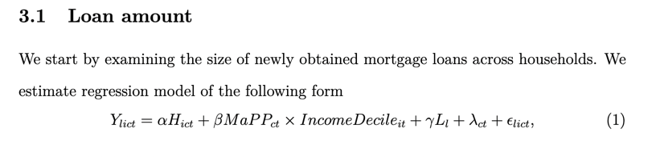
RA2: Explainable Machine Learning.
explanation can be:
relevant example of training set
subset of features
counterfactuals
a free text explanation
court sentence
AJ, “Explainable Empirical Risk Minimization”, arXiv eprint, 2020. weblink
AJ Jung and P. H. J. Nardelli, “An Information-Theoretic Approach to Personalized Explainable Machine Learning,” in IEEE SPL, 2020, doi: 10.1109/LSP.2020.2993176.
Notes:
Our second current research area is explainable machine learning. Our take on this hot topic is to measure the usefulness of an explanation by the amount by which the entropy of the prediction is reduced. An explanation can be any artefact that is revealed together with the prediction. For example, an explanation could amount to selecting a particular training example. Another form of explanations is obtained by listing a set of most relevant features. Formally, we model the explanation and prediction as correlated random variables. This information-theoretic approach is appealing as it allows to take into account the user background knowledge. We characterize the user background by a user summary that is provided by a training set. We use the user summary to design explanations that maximally reduce the uncertainty about a prediction for a specific user.

Slide 6
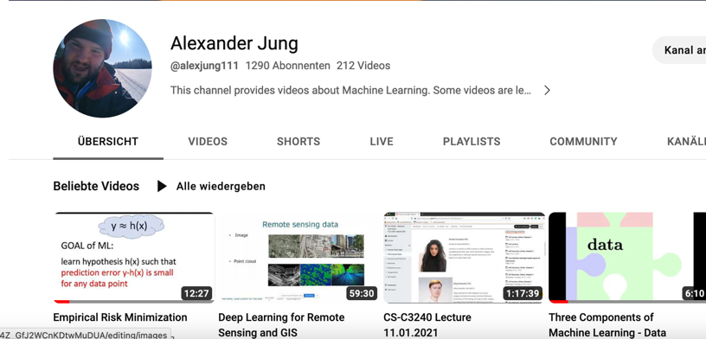
Machine Learning YouTube.
https://www.youtube.com/channel/UC_tW4Z_GfJ2WCnKDtwMuDUA

Slide 7

Machine Learning Book.
available at your favourite
book shop

Slide 8
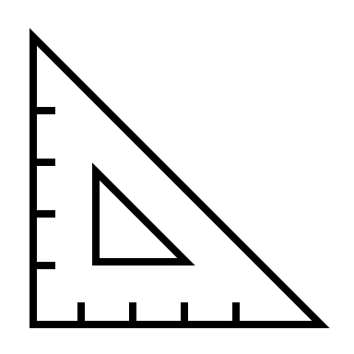


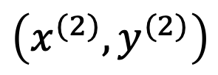

One Slide Summary of ML
label y
$$\hat{y}=h(x)$$
$$\left(x^{(1)},y^{(1)}\right)$$
$$\hat{y}=h^{′}(x)$$
$$\left(x^{(2)},y^{(2)}\right)$$
feature x

Slide 9
Machine Learning.
find hypothesis in model that incurs smallest loss when predicting label of any datapoint

Slide 10
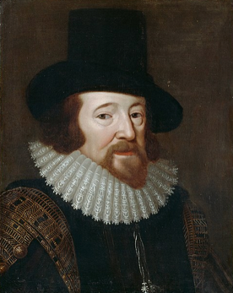
In other words...
ML fits (high-dim.) mathematical models to (huge) amounts of observed data

Slide 11
You cannot avoid machine learning!

Slide 12
1. element
2.
3.
4.
5.
6.
4, 5, 6, 7, 8, ?
“data point”
Notes:
Let me start to explain what generalization is with the help of a game that many of you might have come across already. The game consists of extending a given sequence of objects, e.g., a sequence of numbers. In machine learning we often refer to these individual objects as data points.
Here we have a sequence of five numbers, 4, 5, 6, 7, 8 and the goal is to guess or predict the next element in the sequence. Generalization here means to be able to produce a good guess for the next element in the sequence.

Slide 13
use hypothesis about data generation
to make predictions (forecasts)
Notes:
Machine learning methods learn a hypothesis for the intrinsic structure in observed data. Using this hypothesis, predictions about new elements or future events can be made.

Slide 14
4, 5, 6, 7, 8, ?
“hypothesis”
Notes:
Consider again the sequence we have already shown before. This sequence starts with five numbers, 4, 5, 6, 7, 8. The question is then what could be a good guess for the next element in the sequence. Just by looking at the first five number, many of you might have formed immediately a hypothesis. This hypothesis might be that the sequence elements are linearly increasing according to a straight line. Using this hypothesis, we can predict the next element by continuing the straight line.

Slide 15
“features”
1
1
1
“label”
1/2
1
?
Notes:
Let us consider another instance of the sequence guessing game. In contrast to the previous game, here the sequence elements consist of two parts. The first part, which is known as the features of a data point, is a geometric figure. The second part of each sequence element is a number, the label of this element. Here, the goal is to guess the label of a new sequence element for which we are given the features.

Slide 16
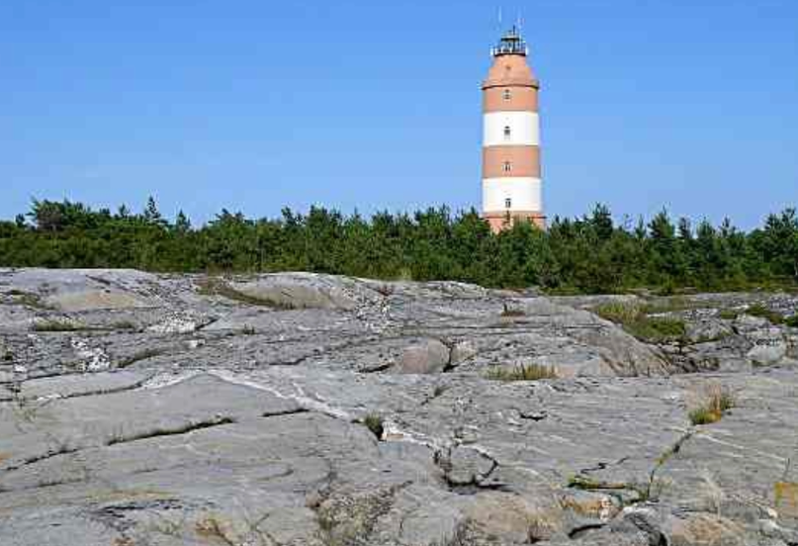
Where?

Slide 17
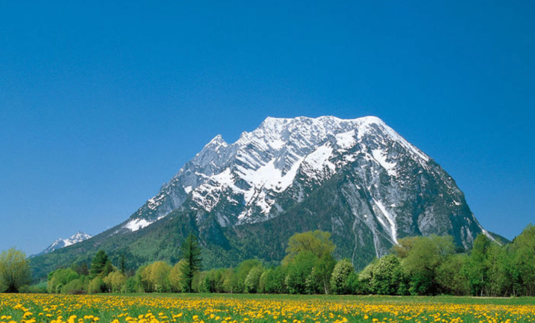
Which mountain?
Which month?

Slide 18
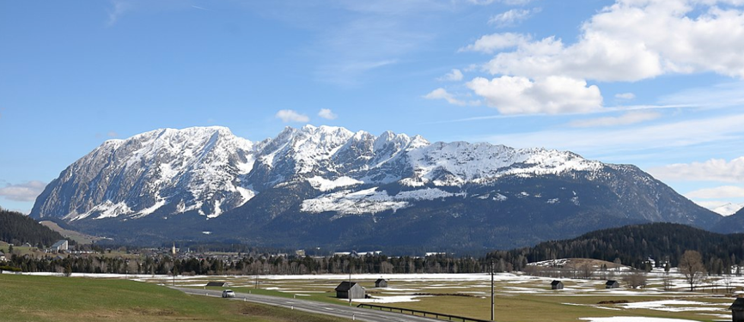
Which mountain?
Which month?

Slide 19

Which place ?
What temp. ?

Slide 20


Slide 21
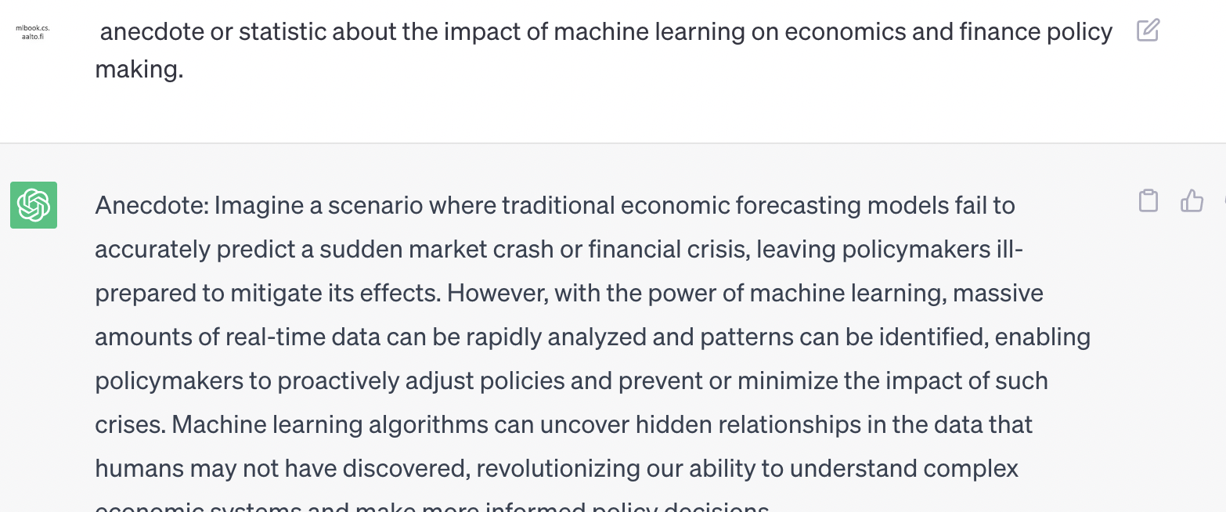

Slide 22
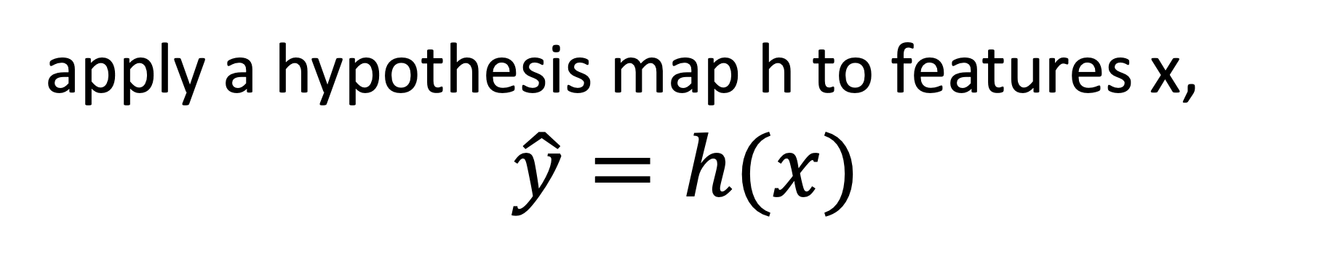
ML Apps
apply a hypothesis map h to features x,
$$\hat{y}=h(x)$$
Q1: How do we now if h is any good?
Q2: How do we find the “optimal” h ?

Slide 23

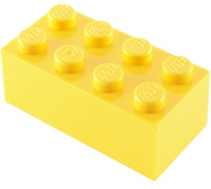
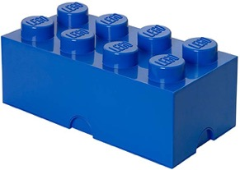
Three Main Components
data (observations)
model (hypothesis space)
loss function (performance measure)

Slide 24
Data

Slide 25
data
= set of datapoints

Slide 26
What is a Datapoint?
some object that carries relevant information

Slide 27
Datapoint = Some Period of Time
1.1.2020 01:00 - 2.1.2020 13:00

Slide 28

Datapoint = Some Country

Slide 29
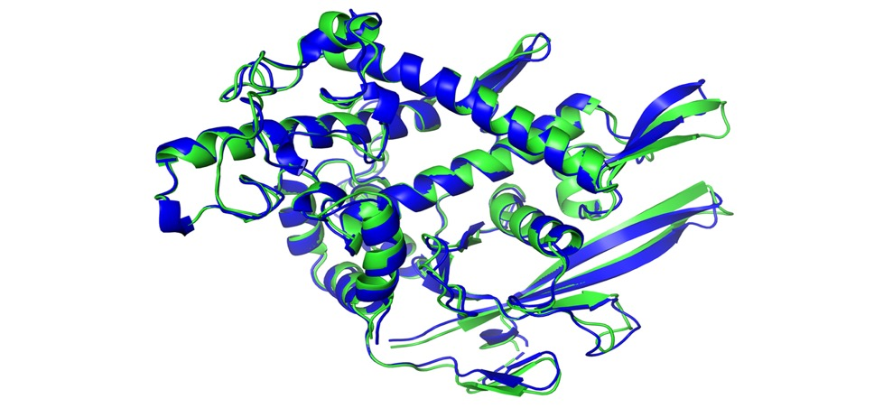
Datapoint = Some Protein

Slide 30
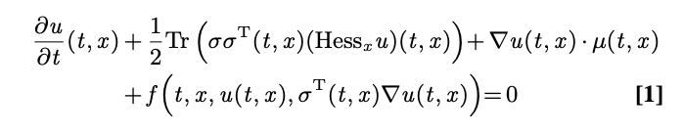
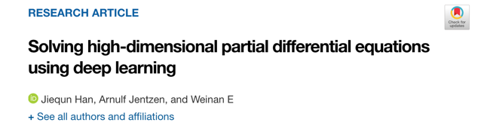
Datapoint = A Partial Differential Equation
https://www.pnas.org/content/115/34/8505/tab-article-info

Slide 31
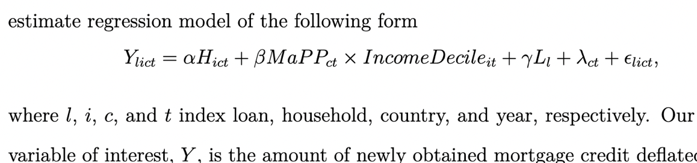
Datapoint = A Household
N. Biljanovska, S. Chen, “Differential Effects of Macroprudential Policy,” 2023.

Slide 32
Features and
Labels.

Slide 33
datapoint characterized by
features: low-level properties; easy to measure/compute
labels: high-level quantity of interest; difficult to measure/determine

Slide 34
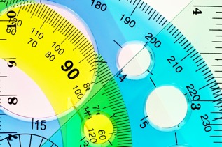



Numeric Features
we mainly use numeric features
x1,…,xn to characterize a datapoint
stack features into feature vector
Python: use numpy array to store features
discuss feature learning methods later

Slide 35
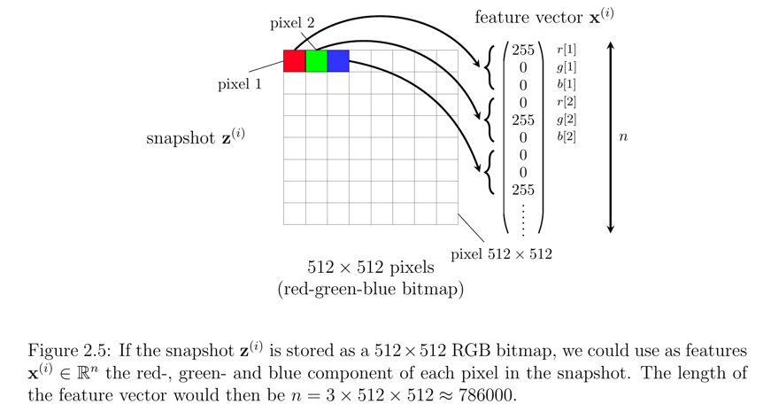
Features of an Image.

Slide 36
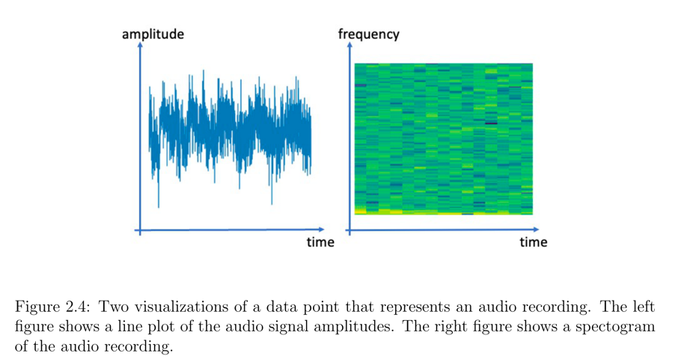
Image of an Audio Recording.

Slide 37
Image of a Protein.

Slide 38
Datapoint = A Partial Differential Equation
features:
label:
https://www.pnas.org/content/115/34/8505/tab-article-info

Slide 39
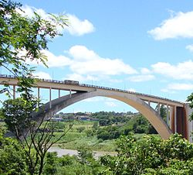
Datapoint = A Bridge
features:
label:
https://commons.wikimedia.org/wiki/Category:Bridges

Slide 40
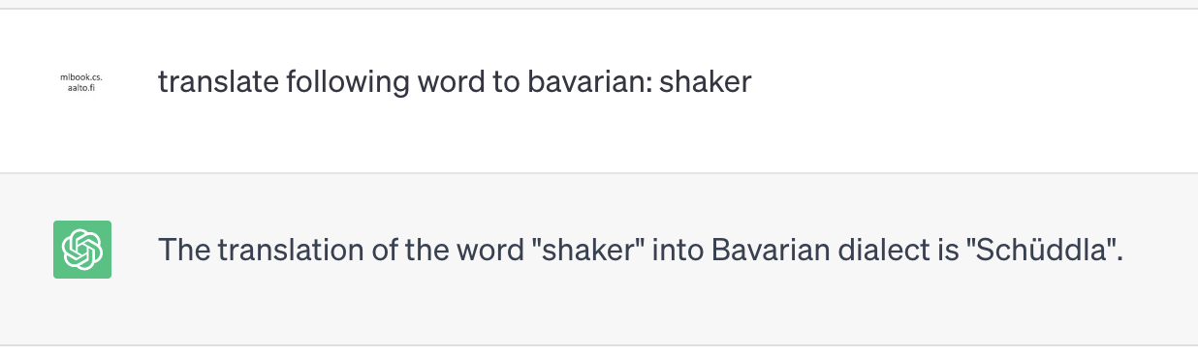
Datapoint = GPT4 prompt
what is the label here?

Slide 41
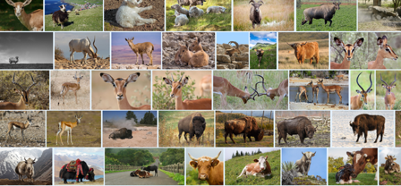
Learn a Feature Map
Foundation Model
g(.)
x
pixels
pretrain foundation model
on large “low-quality” (unlabelled)
dataset

Slide 42
Datapoints, Features, Labels are Design Choices guided by
computational aspects
statistical aspects
legal/ethical aspects

Slide 43
Your Turn!
Which data points arise in your
research ? What are good features,
labels?

Slide 44
Component 2
Model

Slide 45
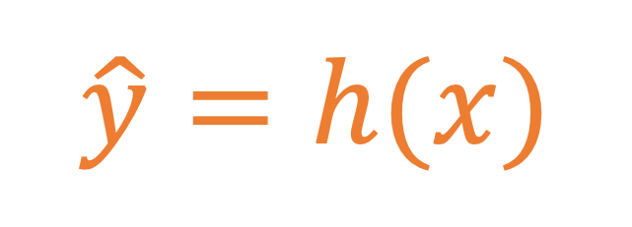
A Hypothesis.
$$\hat{y}=h(x)$$
label y
feature x

Slide 46
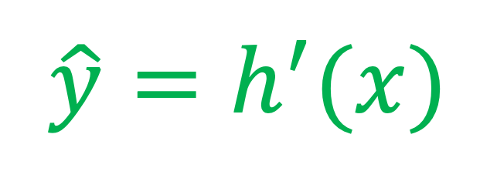
Model = Several Hypotheses.
$$\hat{y}=h(x)$$
label y
$$\hat{y}=h^{′}(x)$$
feature x

Slide 47

Linear Model
label y
feature x

Slide 48
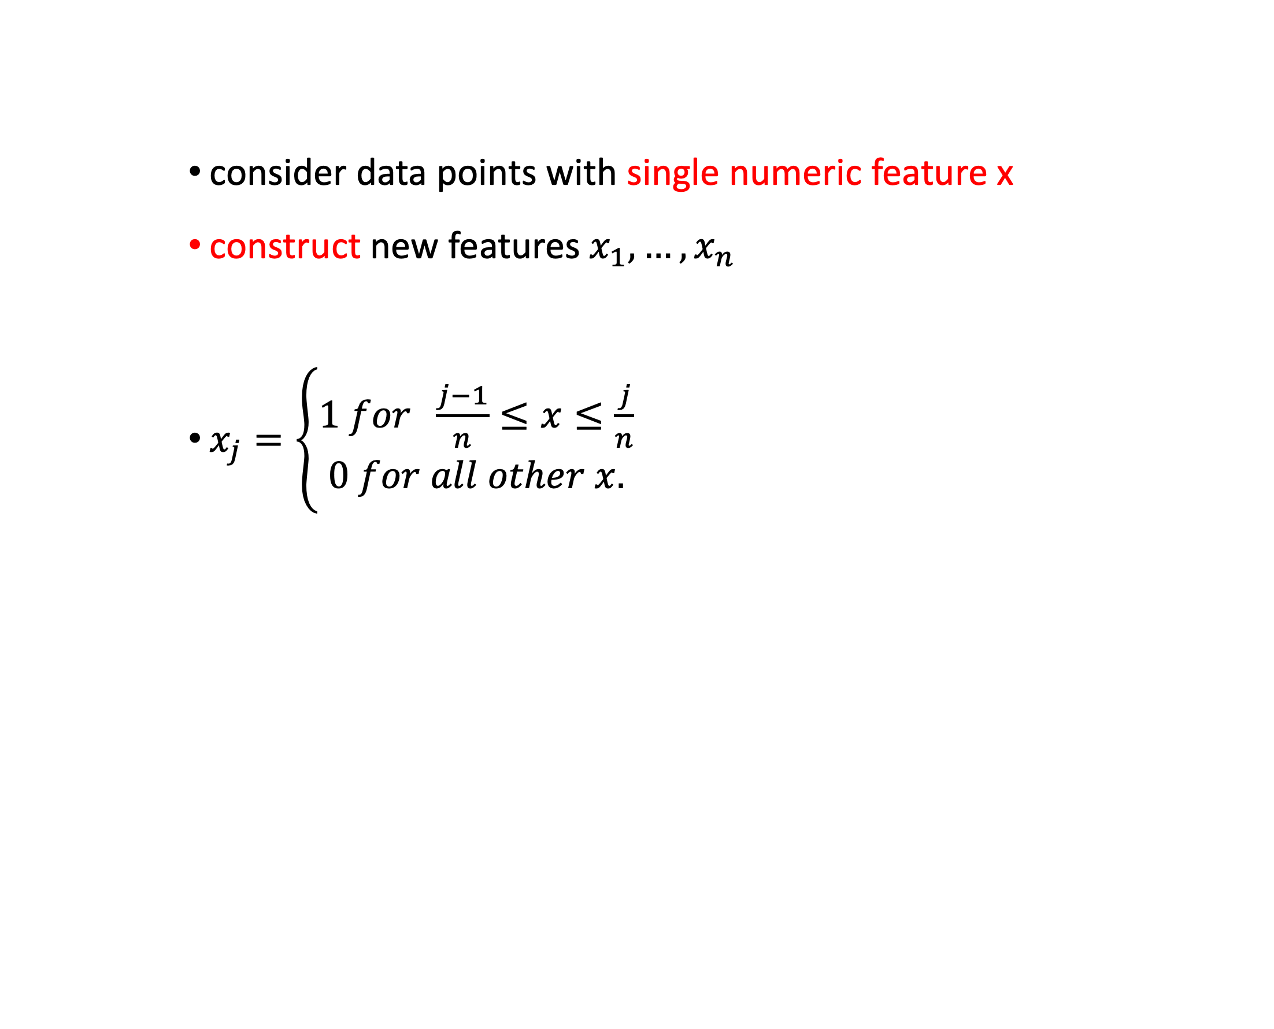
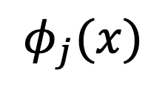
Upgrade Linear Model with new Features !
consider data points with single numeric feature x
construct new features $x_{1},…,x_{n}$
$x_{j}=\left\{\begin{aligned}1 for \frac{j−1}{n}≤x≤\frac{j}{n} \\ 0 for all other x.\end{aligned}\right.$
$$φ_{j}(x)$$
1
x
(j-1)/n
j/n
1

Slide 49
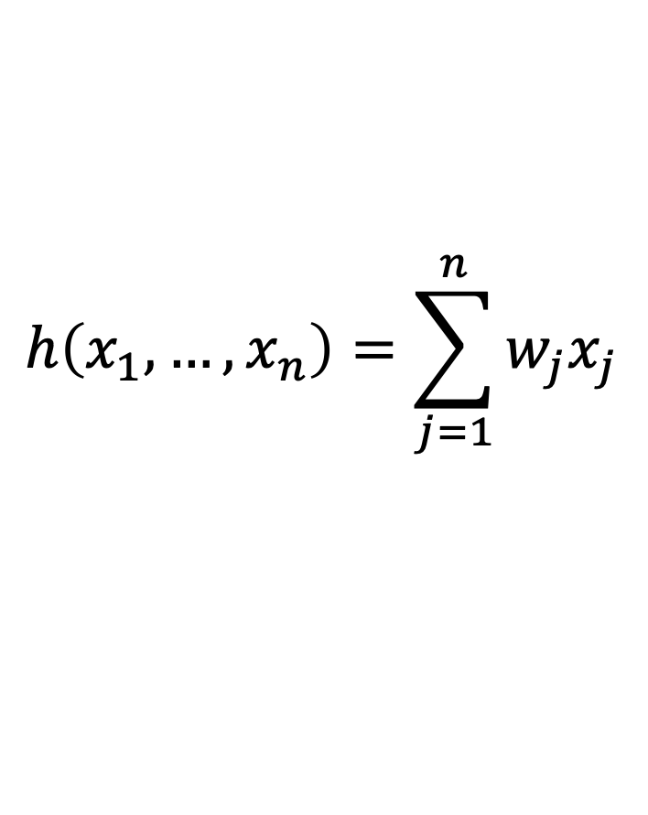
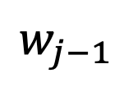

You Can Do Anything with Linear Predictors!
h(x) is linear in new features but non-linear in raw feature x!
$$h\left(x_{1},…,x_{n}\right)=\sum_{j=1}^{n}{w_{j}x_{j}}$$
$$w_{j}$$
$$w_{j−1}$$
x
(j-2)/n
(j-1)/n
j/n
1

Slide 50


Foundation Model = Feature Map!
Foundation Model
g(.)
z
lin. map
f(.)
x
h(x)
pretrain foundation model
on large “low-quality” (unlabelled)
dataset
fine-tune output of model
on a small high-quality (labeled) dataset
https://arxiv.org/pdf/2108.07258.pdf

Slide 51
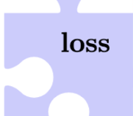



Slide 52
Which Hypothesis is Better?
$$\hat{y}=h(x)$$
label y
$$\hat{y}=h^{′}(x)$$
feature x

Slide 53
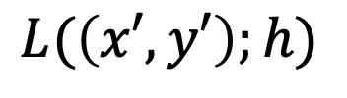
A Loss Function
$$\hat{y}=h(x)$$
label
(x’,y’)
$$L(\left(x′,y′\right);h)$$
quantitative measure of prediction error obtained
when using hypothesis h to predict label y’ of datapoint
with feature x’
feature

Slide 54
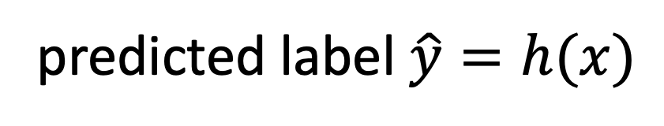
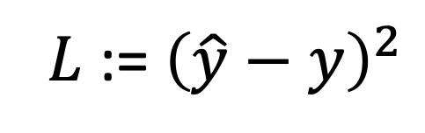

The Squared Error Loss
$${L \text{:= }\left(\hat{y}−y\right)}^{2}$$
$$y$$
predicted label $\hat{y}=h(x)$

Slide 55
Unsupervised Learning
label = cluster index (1 or 2)
clustering methods (such as “k-means”) do not require true label for
any data point !
Ch. 8 in MLBook

Slide 56


Reinforcement Learning
features = on-board
camera video
label = “optimal steering
direction”

Slide 57
Main Components of ML
data
model
loss

Slide 58
Landscape of ML Methods
loss
data
linear regression
kNN
decision tree
logistic regression
k-means
model

Slide 59
Thank you !

Slide 60
What Data, Model, Loss?
statistical aspects (highly accurate predictions)
computational aspects (efficient use of resources)
trustworthy (transparency, privacy protection)

Slide 61
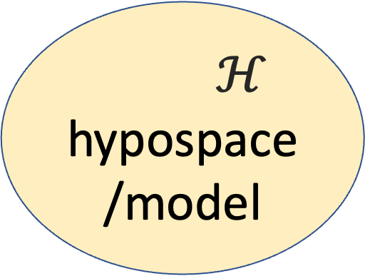
Data and Model Size
$$\left(x^{(1)},y^{(1)}\right)$$
training set
m
$$\left(x^{(2)},y^{(2)}\right)$$
$ℋ$
hypospace/model
$$\left(x^{(m)},y^{(m)}\right)$$
nr. of features n
crucial parameter is the
ratio d/m
eff. dimension d
Notes:
The sample size m is the nr. of different datapoints in the training set

Slide 62
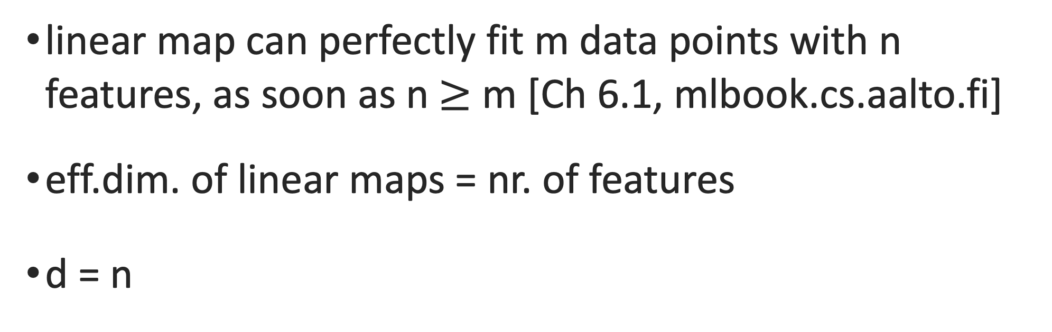
Effective Dim. Linear Maps
linear map can perfectly fit m data points with n features, as soon as n $≥$ m [Ch 6.1, mlbook.cs.aalto.fi]
eff.dim. of linear maps = nr. of features
d = n

Slide 63
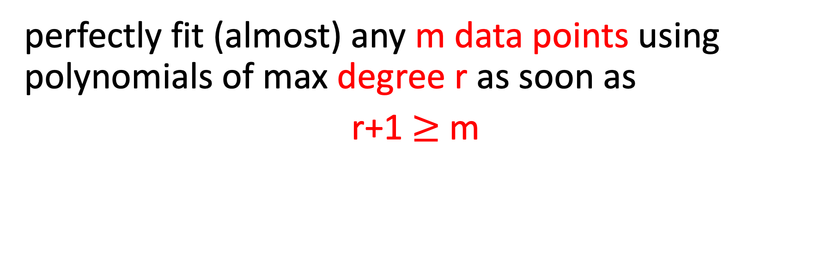
Effective Dim. Polyn. Reg.
perfectly fit (almost) any m data points using polynomials of max degree r as soon as
r+1 $≥$ m
-> d = r+1 (effective dim. of polyn. regression equals the max. polyn. degree plus one!)

Slide 64
m=2, degree r=1 polynomial
label y
feature x

Slide 65
m=3, degree r=2 polynomial
label y
feature x

Slide 66
Data Hungry ML Methods
millions of features for datapoints (e.g. megapixel image)
eff.dim. d of linear maps is also millions
eff.dim d of deep nets is millions … billions
can perfectly fit any set of 100000s (!) of datapoints
training error will be zero (overfitting!)

Slide 67
training error
validation error
“critical value” (d/m=1)
d / m
adjust model and/or data to reach

Slide 68
how to bring d/m below critical value?
increase available nr. m of training data by
  data augmentation
  change def. of labels (self-supervised learning)
decrease d by regularization

Slide 69
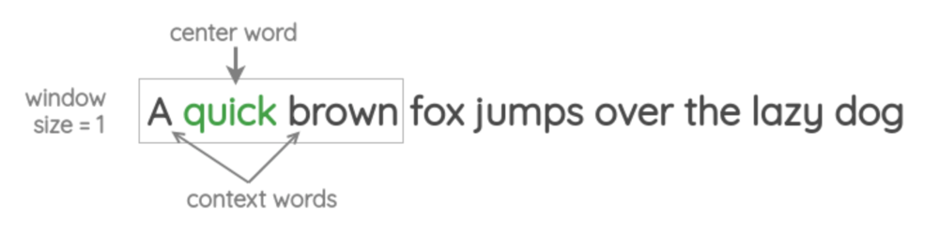
Self-Supervised Learning
https://amitness.com/2020/05/self-supervised-learning-nlp/

Slide 70
Data Augmentation
Notes:
consider the first option to ajdust the ratio d/m. We could collect more data points for training set. Wha tcould be the problem here ? Note that we must know the labels of datapoints in the trainig set.However, we can use some domain knowledge do generate new datapoints synthetically(simulate it).

Slide 71
add a bit of noise to features
original datapoint
label y
augmented
feature x
we have increased the dataset by factor 3 !

Slide 72

rotated cat image is still cat image

Slide 73
flipped cat image is still cat image

Slide 74
shifted cat image is still cat image

Slide 75
Regularization
does implicit
Data Augmentation

Slide 76
augment with (infinitely many) realizations of RV!
label y
original datapoint
augmented
=
+ ”noise”
feature x

Slide 77
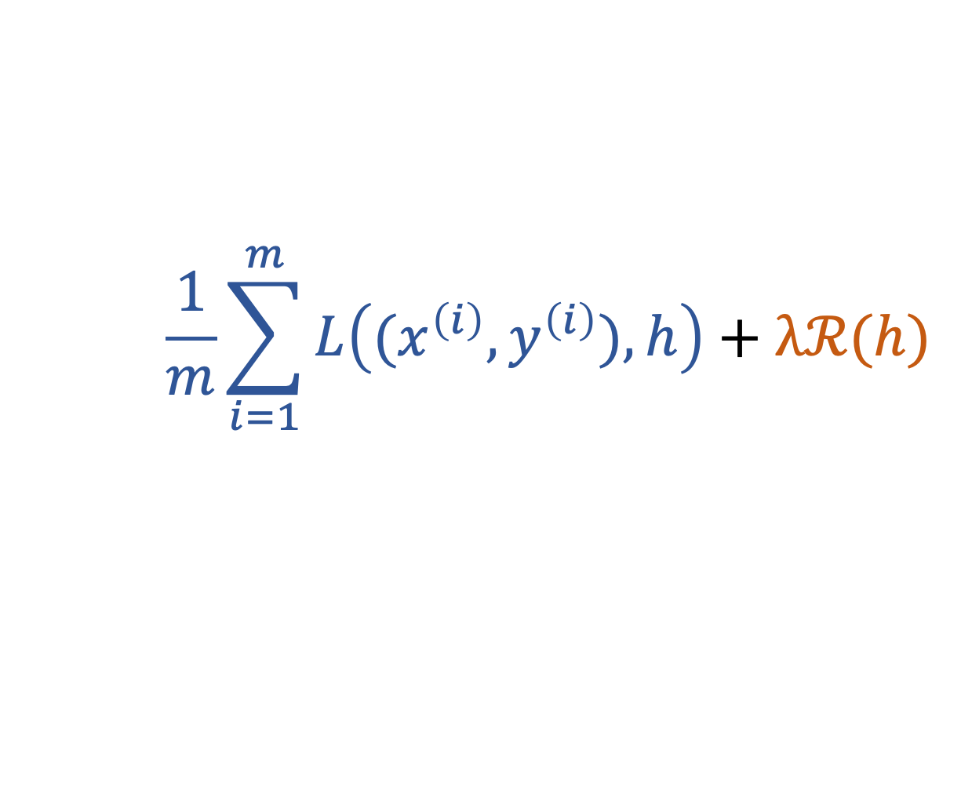
Regularization =Implicit Data Aug.
raw datapoint
label y
h(x)
“perturbed”
datapoint
$$\frac{1}{m}\sum_{i=1}^{m}{L\left((x^{\left(i\right)},y^{\left(i\right)}),h\right)}+λℛ(h)$$
see Chapter 7.3 of mlbook.cs.aalto.fi
feature x
Notes:
If we use a larger number of perturbed copies for each datapoint in the original training set, we obtain an average loss which consists of the original training error and
another comoennts due to the perturbed datapoints. This additoinal component is approximately equal to the reguarlization term used in regularized ERM.

Slide 78
To sum up,
large ratio d/m leads to overfitting
reduce d by using smaller model (“pruning”)
increase m by using more data points
regularization is a soft model pruning
regularization does implicit data augmentation

Slide 79
Questions ?

Slide 80
Advanced Topics

Slide 81
Transfer Learning
via
Regularization

Slide 82
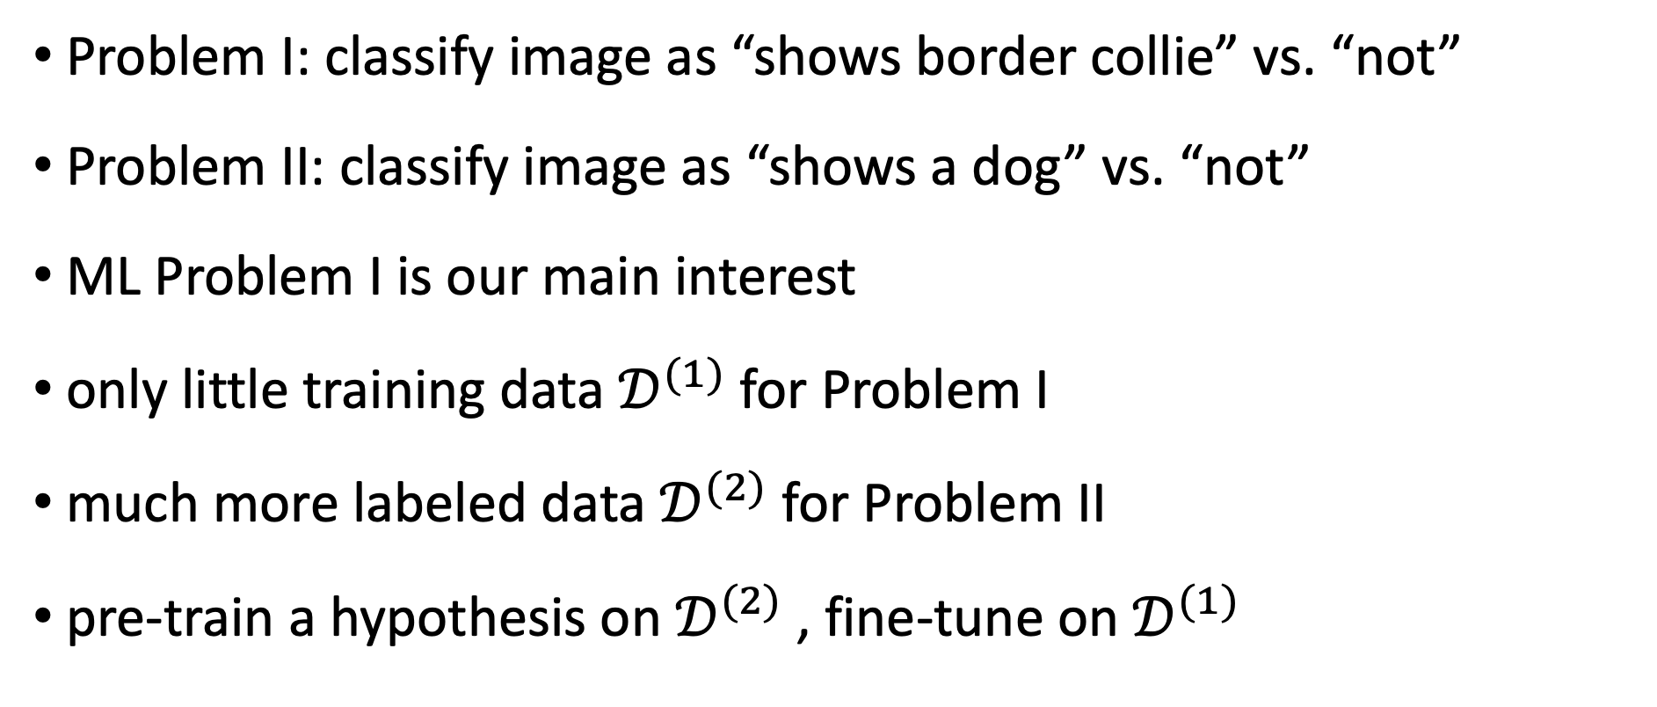
Problem I: classify image as “shows border collie” vs. “not”
Problem II: classify image as “shows a dog” vs. “not”
ML Problem I is our main interest
only little training data $𝒟^{(1)}$for Problem I
much more labeled data $𝒟^{(2)}$ for Problem II
pre-train a hypothesis on $𝒟^{(2)}$, fine-tune on $𝒟^{(1)}$

Slide 83
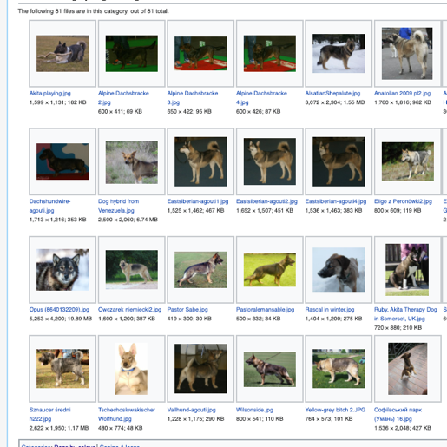
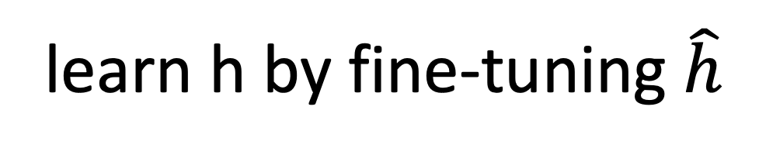
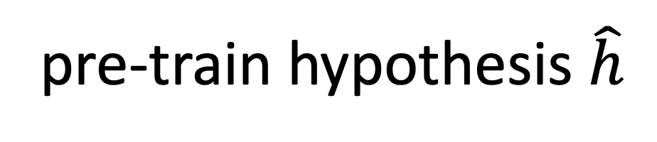


$$𝒟^{(1)}$$
$$𝒟^{(2)}$$
learn h by fine-tuning $\hat{h}$
pre-train hypothesis $\hat{h}$

Slide 84
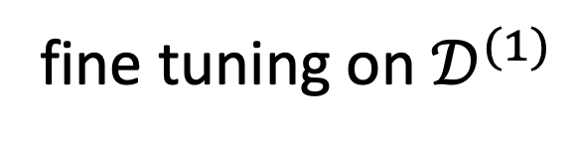
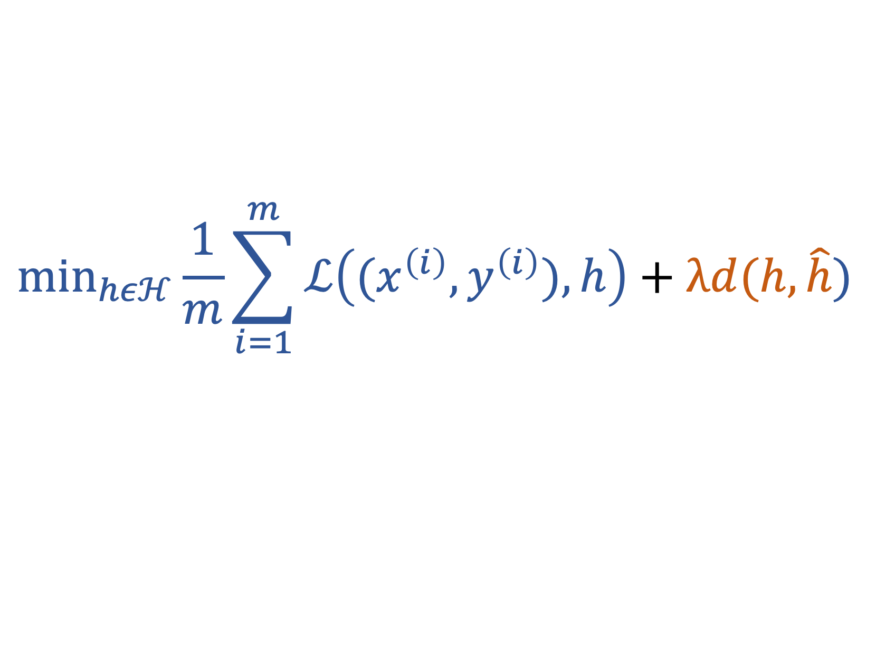
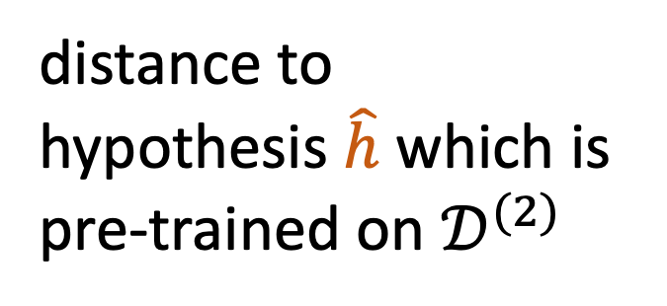
$${\text{min}}_{hεℋ}\frac{1}{m}\sum_{i=1}^{m}{ℒ\left((x^{\left(i\right)},y^{\left(i\right)}),h\right)}+λd(h,\hat{h})$$
distance to
hypothesis $\hat{h}$ which is
pre-trained on $𝒟^{(2)}$
fine tuning on $𝒟^{(1)}$

Slide 85
Multi-Task Learning
via
Regularization

Slide 86
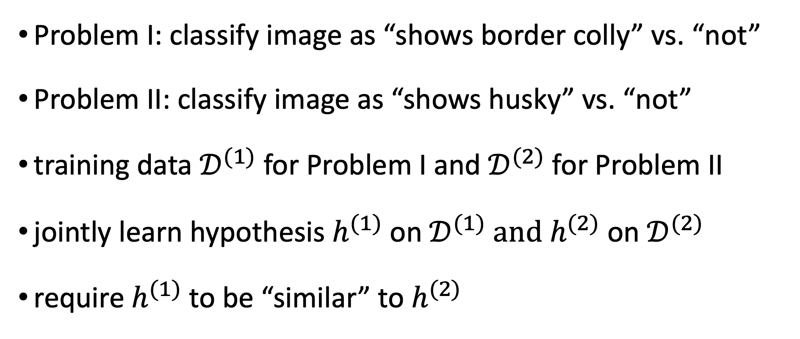
Problem I: classify image as “shows border colly” vs. “not”
Problem II: classify image as “shows husky” vs. “not”
training data $𝒟^{(1)}$for Problem I and $𝒟^{(2)}$ for Problem II
jointly learn hypothesis $h^{(1)}$ on $𝒟^{(1)}$ and $h^{(2)}$ on $𝒟^{(2)}$
require $h^{(1)}$ to be “similar” to $h^{(2)}$

Slide 87





$$𝒟^{(1)}$$
$$𝒟^{(2)}$$
jointly learn similar
$h^{(1)}$ and $h^{(2)}$ for each dataset

Slide 88




training error of $h^{(1)}$
training error of $h^{(2)}$
$$\begin{matrix}min & \begin{aligned}ℇ\left(h^{\left(1\right)} | 𝒟^{\left(1\right)}\right)+ℇ\left(h^{\left(2\right)} | 𝒟^{\left(2\right)}\right) \\ +λd(h^{(1)},h^{(2)})\end{aligned} \\ h^{(1)},h^{(2)} & \end{matrix}$$
“distance” between $h^{(1)}$ and $h^{(2)}$

Slide 89
Semi-Supervised Learning
via
Regularization

Slide 90

classify image as “shows border colly” vs. “not”
small labeled dataset $𝒟^{(1)}$
massive image database $𝒟^{(2)}$ with unlabeled images
train hypothesis h(.) on $𝒟^{(1)}$with following structure:
feature map
g(.)
z
lin. map
f(.)
x
h(x)

Slide 91

$$𝒟^{(1)}$$
$$𝒟^{(2)}$$
learn linear classifier f(.)
learn feature map g(.)

Slide 92


${\text{min}}_{hεℋ}\frac{1}{m}\sum_{i=1}^{m}{ℒ\left((x^{\left(i\right)},y^{\left(i\right)}),h\right)}+λ$ $ℇ\left(g | 𝒟^{\left(2\right)}\right)$
use training error
to fine tune f(.)
learn feature map g(.)
using large unlabeled
database $𝒟^{\left(2\right)}$

